Slide 1
Medical Equipment Problems:
Tracheostomies and Gastrostomies
View in presentation mode for best experience
Adapted From the National Pediatric Nighttime Curriculum: Caroline Rassbach, MD
(Lucile Packard Children’s Hospital, Stanford)
Updated 06/2020 MZ

Slide 2


Learning Objectives
Review the critical components of tracheostomy and gastrostomy tubes
Begin initial management of tracheostomy emergencies
Troubleshoot problems with gastrostomy tubes

Slide 3
Case 1
You are called at 2am to evaluate carie who is a 3 year old with trach and who is desaturating.
  DISCUSSION: What other information would you like to know?
  What would make you call Ent emergently?
    Is this a new or old tracheostomy? What size is the patient’s trach, when was it last changed?
      If the trach site is new, stoma may collapse upon trying to change the trach, ent should be called immediately. May require oral intubation.
      If older trach, stoma is likely well-established and you can therefore replace trach and confirm with etCo2
Notes:
-large amounts of blood
-ongoing bleeding
-increasing oxygen requirement

Slide 4
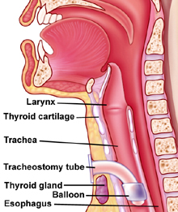
TracheostomY

Slide 5
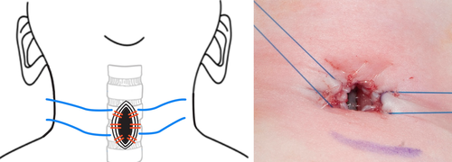
Post-operative stay sutures
Typically removed after the first trach change approximately 1 week after surgery
Traction on the sutures in the case of dislodgement can help with Recannulation in the post-operative period

Slide 6
Dislodged trach: trach properties
Discussion: what is the difference between a cuffed and uncuffed tracheostomy?
  See following slides for examples

Slide 7
Uncuffed Trach
Tracheostomy (uncuffed). Brand name and size are usually printed on the sides of the trach on the flanges)
Shiley 4.0
adapter
flange
canula
Obturator (guides placement)
Children’s Hospital of Greenville Health System: Guide for Pediatric Tracheostomy care 9/17

Slide 8
Cuffed Tracheostomy tube
The cuff is an inflatable, balloon on the trach tube. By adding water to the balloon, it expands and produces a seal.
This typically leads to less air leak than uncuffed tubes
cuff
Children’s Hospital of Greenville Health System: Guide for Pediatric Tracheostomy care 9/17

Slide 9
HME (heat and moisture exchanger)
Humidifying filter (must be changed daily to prevent plugging). Used to help add moisture and keep secretions thinner.
Mist collars may be worn by children not on a ventilator.
Children’s Hospital of Greenville Health System: Guide for Pediatric Tracheostomy care 9/17

Slide 10
Next steps
Discussion: what are some steps you can take to trouble shoot the hypoxia and what is your differential??
  See next slide for emergency trach procedures and the following slide for differential

Slide 11
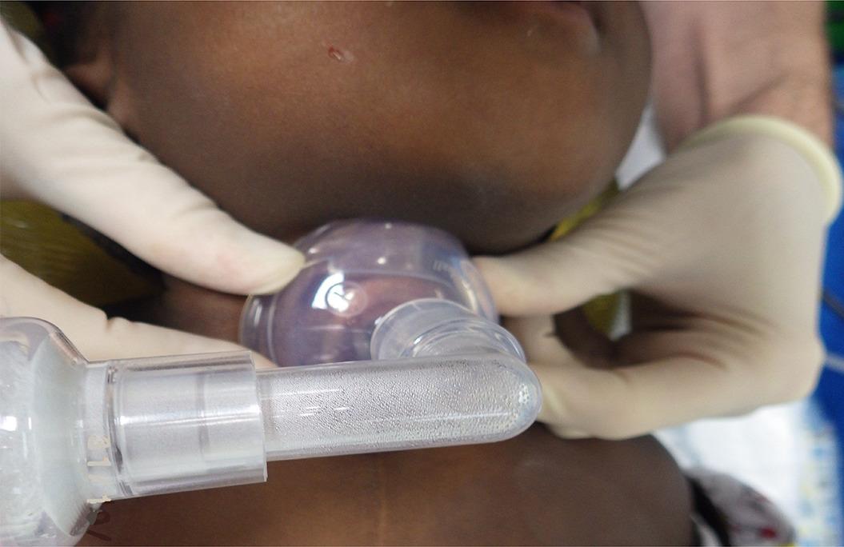
Emergency trach procedures
Stay
Stay calm. Focus on Airway, breathing, circulation. Trouble shoot ventilator connections if applicable, provide oxygen
Suction
Suction the trach
Change
If difficulty continues, change the trach.
Provide
Provide breaths using the resuscitation bag/ambu bag
Provide
If chest not rising or breath sounds cant be heard, provide breaths using mask on the child’s mouth and nose
Call
Call for backup, transfer to higher level of care

Slide 12

Differential Diagnosis of Desaturation in a Patient with Tracheostomy
Problem | Treatment
Obstruction: Mucous plugging | Suction; replace trach if needed
Tube improperly placed against tracheal wall | Reposition trach
Decannulation | Replace trach
Pneumothorax | Needle decompression
Notes:
-Review the causes and treatment of desaturation in a child with a tracheostomy tube

Slide 13
Differential Diagnosis of Trach Bleeding
Problem | Treatment/Prevention
Bleeding from stoma: Trauma at stoma site | Apply pressure, avoid trauma
Granuloma at stoma site | Triamcinolone, silver nitrate
Infection at stoma site | Antibiotics
Internal bleeding: Trauma from suctioning | Measure suction catheter; do not suction beyond length of trach tube; suction for 10 sec or less at a time.
Tracheal wall granuloma | ENT eval, possible excision
Tracheal wall erosion | ENT evaluation
Tracheal erosion into an artery | Emergent ENT evaluation
Pulmonary hemorrhage | Respiratory/ventilator support
Notes:
-Review the various causes and treatments of tracheostomy bleeding

Slide 14
Video of tracheostomy change
Practice in a non-emergent environment during routine trach changes
https://www.youtube.com/watch?v=RNEVJzf9LIc

Slide 15
Case 2
A nurse calls you to evaluate a child with a gastrostomy tube because of excessive leaking of formula around the site.
  DISCUSSION: What are potential causes?
    Small amount of leakage may be normal
    Crack in tubing
    Enlarged g-tube insertion site
    Improperly connected

Slide 16
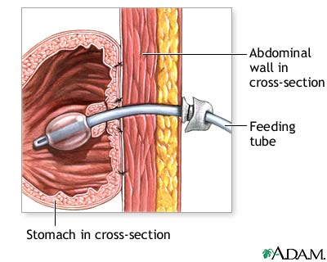
Gastrostomy Tube
Ballon inserted into stomach to prevent tube from being pulled out
External disc should rest close to the skin to prevent excessive traction
Stomach becomes affixed to the abdominal wall with time, but there is a potential space between the abdominal wall and the stomach

Slide 17
Drainage around Gastrostomy Tube
A small amount of drainage is acceptable
Keep area dry using nonadherent gauze or foam; do not use occlusive dressings which may retain moisture and promote infection
Ensure no cracks in tubing
Ensure no excessive traction on tube which can stretch the stoma
If drainage persists, may need to upsize tube
In severe cases, may require surgical repair

Slide 18
Gastrostomy Problems: Tube Blockage
Tube blockage commonly results from medications, especially pills, which are crushed and obstruct the lumen
Options for treatment of blockage:
Water
Carbonated beverage
Pancreatic enzymes
Replace tube
Change to liquid medications, if possible

Slide 19
Tube Displacement
Stoma can close within hours if not held open
Management: Keep site open!!!
Insert a foley catheter or red rubber into the stoma
Notify surgeon or GI who placed the tube
Verify placement: draw back gastric contents, x-ray, or dye study can be used to confirm placement. If not, risk of false track→ peritonitis especially in tubes 4-6 weeks old
Notes:
-tube placement may be checked by drawing back gastric contents, performing an x-ray, or performing a dye study in which contrast is injected into the gastrostomy and fluoroscopy is used to ensure the contrast enters the stomach

Slide 20
Erythema surrounding g-tube
Discussion question: what are some causes of redness around g-tube?
  See next slide

Slide 21
Redness Around Gastrostomy Site
Causes | Treatment/Prevention
Granulation tissue | Treatment: triamcinolone cream > silver nitrate > surgical excision Prevention: avoid excessive traction and occlusive dressings
Infection Yeast infection Cellulitis/necrotizing fasciitis | Topical vs. systemic antifungals Systemic antibiotics
Irritation from gastric fluid leakage | Barrier creams; gastric acid suppression
Tape sensitivity | Avoidance of tape

Slide 22
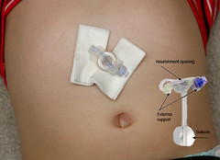
Gastrostomy Problems: Vomiting
DISCUSSION: What are some causes of vomiting?
  GERD (may worsen after gastrostomy placement)
  Gastrostomy balloon obstructing gastric outlet
  Other medical causes (ex. motility issues)
  For refractory cases, consider Gj tube or Nissen
This Photo by Unknown Author is licensed under CC BY-NC-ND
Notes:
-GERD may be treated with medications, by slowing down feeds, or by concentrating feeds to decrease total volume. Occasionally a trial of a more elemental formula is used.
-for refractory cases of GERD, consider gastro-jejunostomy tube placement or Nissen fundoplication
-A gastrostomy balloon may obstruct the pylorus. In this case, the balloon may be gently deflated and then re-inflated, sometimes with less water, to clear the obstruction. Caution should be used to avoid dislodging the tube during this process. Of note, this technique should not be performed in new gastrostomies (less than 6 weeks old) due to concern for displacement of the tube.

Slide 23
Venting the G-tube
Venting the G-tube is used to treat bloating, distention, or gagging/vomiting.
2 ways of venting the tube:
Draw back excess air/fluid from the gastric port using an empty syringe
Attach a drainage device to the G-tube port, such as a drainage bag (ex. Farrell bag).

Slide 24
Take-home Points
Tracheostomy problems should first be evaluated by checking the ABCs
If a gastrostomy tube is dislodged, a foley catheter should be immediately placed in the lumen to keep the site open
to discuss any new or unfamiliar tracheostomy or gastrostomy problems consider contacting specialist who placed the device, especially if newly placed

Slide 25
Suggested reading
Pediatrics in review January 2017: Tube feeding in children
  specifically complications section
  https://pedsinreview.aappublications.org/content/38/1/23#T6
Journal of respiratory care 2017: Tracheostomy in infants and children
  Specifically the tracheostomy tube types and complications of tracheostomy
  http://rc.rcjournal.com/content/62/6/799

Slide 26
References
American Thoracic Society: Care of the Child with a Chronic Tracheostomy. Am J Respir Crit Care Med. 2000;161:297-308.
Haffner JC, Schurman SJ. The Technology-Dependent Child. Pediatr Clin N Am. 2001;48:751-64.
Mukherjee S et al. Common Skin Problems in Children with Special Healthcare Needs. Pediatric Annals. 2010;39:206-215.
Srivastava R et al. Hospitalist Care of the Medically Complex Child. Pediatr Clin N Am. 2005;52:1165-87.
Srivastava R et al. Dysphagia and Gastroesophageal Reflux Disease: Dilemmas in Diagnosis and Management in Children with Neurological Impairment. Pediatric Annals. 2010;39:225-31.

