Slide 1
Acute Respiratory Distress
Inpatient Night Float curriculum
Please use PowerPoint presentation mode to facilitate discussion
Adapted from the National Pediatric Nighttime Curriculum written by Liane Campbell, MD (Stanford University)
Updated 06/20 MZ

Slide 2
Objectives
Review the initial assessment of a patient in respiratory distress
Review management of specific causes of respiratory distress

Slide 3
Signs of respiratory distress
DISCUSSION QUESTION: What are some signs of respiratory distress or impending respiratory compromise?
  Signs of increased work of breathing: retractions, nasal flaring, tachypnea for age
    Attempt to improve minute ventilation in response to hypoxemia or hypercarbia
  Abnormal breath sounds: stridor, wheezing, crackles, diminished aeration, transmitted upper airway sounds, prolonged expiration
  Decreased or absent effort: bradypnea or altered mental status (disordered control of breathing– ex. From overdose or head injury)

Slide 4
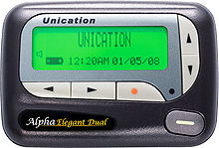
It’s midnight!
DISCUSSION QUESTION:
What additional information would you want to know?
How long was the desaturation? Was there a good waveform? What is the general appearance? Are there other signs of respiratory distress? Was the nasal canula in place?
5003: Sally, 2 year old with PNA had a desaturation to 86% on 1L NC
From: RN Sandy on 7/1 at 00:45
This Photo by Unknown Author is licensed under CC BY-SA

Slide 5
Sally is still hypoxemic
Upon assessment, you note that the nasal canula is in place, has a good waveform, and she is still hypoxemic to 75% on 1L NC.
DISCUSSION QUESTION: What management steps should you take?
  Rapidly assess the severity , titrate oxygen
  Call for backup: Call Respiratory Therapy, call senior resident, consider calling a rapid response
  Assess your ABCs

Slide 6
Don’t forget your ABC’s
1. AIRWAY:
Optimize patient position (make sure they are not hyperextended or hyperflexed, open airway)
Suction any secretions
2. BREATHING:
Increase the flow of the nasal canula
Consider alternate oxygen device such as high flow nasal canula, CPAP, or non-rebreather
Consider albuterol if wheezing/ has a history of underlying obstructive lung disease
If patient is in respiratory failure, begin bag mask ventilation, prepare for intubation
3. CIRCULATION:
Establish vascular access

Slide 7
Sally is very sleepy, it is difficult to keep her awake and she is breathing very hard
DISCUSSION QUESTION: What imaging/ labwork would you obtain?
Obtain a Chest x-ray to evaluate for complications such as parapneumonic effusion
Consider ABG/ VBG and BMP if patient is in respiratory failure to determine pH, pCO2 and HCO3.
If patient is altered, consider obtaining glucose. For unknown causes of altered mental status/ new admissions, consider UDP as well.

Slide 8

Life threatening conditions:
DISCUSSION: What are some examples of life threating conditions that can present with respiratory distress or hypoxemia?
  Tension pneumothorax: absent breath sounds on affected side, tracheal deviation
  Pulmonary embolism: chest pain, tachycardia, tachypnea
  Cardiac tamponade: Apnea, tachycardia, hypotension, respiratory distress
  Complete upper airway obstruction (ex. Epiglottitis, foreign body, anaphylaxis)
  Respiratory failure: Altered mental status, tachypnea, bradypnea, apnea

Slide 9
Categories of respiratory distress
Upper airway obstruction
Lower airway obstruction
Lung tissue disease
Disordered control of breathing

Slide 10
Upper airway obstruction
DISCUSSION QUESTION: What are some causes of upper airway obstruction?
  Foreign body, tissue edema (ex. Anaphylaxis), trauma, viral infection (ex. croup), tongue movement to posterior pharynx with decreased consciousness.
DISCUSSION QUESTION: What are some symptoms of upper airway obstruction?
  Stridor, choking, gagging, vocal changes (“hot potato voice”), inability to cry or vocalize
DISCUSSION QUESTION: What are some important steps in management?
  Avoid agitation, suction only if blood or debris is present
  Reduce airway edema with racemic epinephrine or corticosteroids
  Keep NPO
  For anaphylaxis, additional symptoms may include vomiting, diarrhea, hives, facial swelling, wheezing, and hypotension. Give IM epinephrine

Slide 11
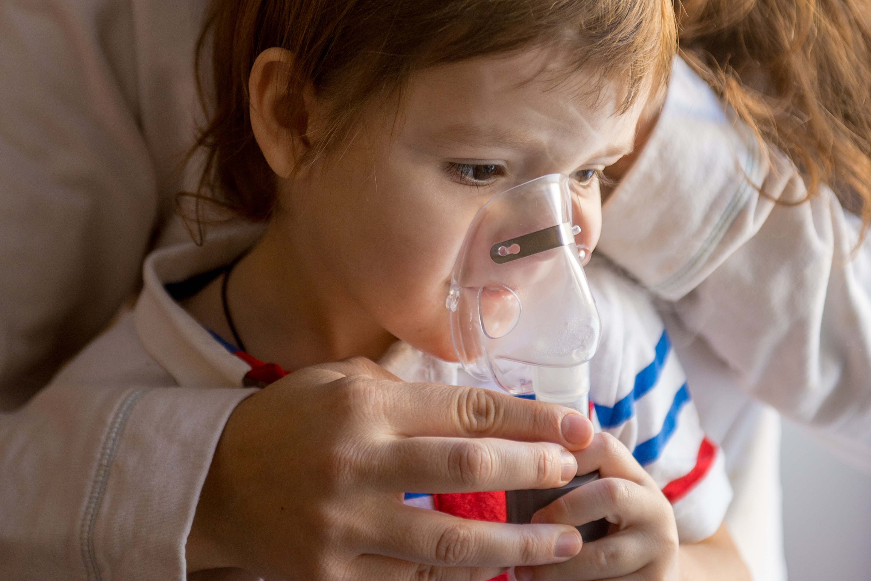
Lower airway obstruction
DISCUSSION QUESTION: What are some causes of lower airway obstruction?
  Asthma, Bronchiolitis
Asthma:
  Symptoms: wheezing, tachypnea, hypoxemia
  DISCUSSION QUESTION: Name some treatments?
    Oxygen, albuterol, corticosteroids. Other therapies include ipratropium, magnesium sulfate, terbutaline, heliox, BiPap, and intubation (try to avoid)
Bronchiolitis:
  Symptoms: rhinorrhea, wheezing, crackles, children less than 2 years
  Management: suctioning and saline, supportive care with oxygen, consider hypertonic saline

Slide 12
Case 2
John is a 2 year old with muscular dystrophy who is BiPap dependent at night. He is in the hospital due to a recent seizure episode. He is typically on BiPap at night with settings 18/5. His oxygen requirement has increased to 40% from baseline of 21%. He is febrile to 39.2 C.
DISCUSSION QUESTION: What steps would you take to evaluate and manage him?
  Patients with muscular dystrophy have restrictive lung disease, have increased risk of atelectasis and pneumonia. Another consideration given history of recent seizure could be aspiration pneumonia
    Perform a thorough physical exam to evaluate for crackles/ diminished aeration and focal findings
    X-ray to evaluate for infiltrate

Slide 13
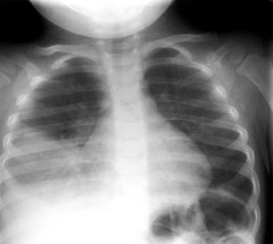
Case 2: CXR
DISCUSSION: Read the CXR.
Use a systematic approach:
  Airway- Midline
  Bones- no fractures
  Cardiac silhouette- no cardiomegaly. Obscuration right heart border
  Diaphragm: obscuration of right diaphragm
  Everything else: no lines or tubes, focal right lower lobe infiltrate concerning for pneumonia
https://emedicine.medscape.com/article/1926980-overview

Slide 14
Case 2 discussion Continued
Start
Start antibiotics focal infiltrates and clinical exam consistent with pneumonia
Give
Give antipyretics
Obtain
Obtain venous blood gas to evaluate for CO2 retention and adjust Bipap as indicated with pulmonology
Consider
Consider transfer to higher level of care if continues to worsen

Slide 15
Types of Lung tissue disease
Infectious pneumonia
  Fever, tachypnea, hypoxemia, increased work of breathing, crackles/ decreased breath sounds
Aspiration pneumonia
  Coughing/gagging associated with feeding, history of neurologic disease
Non-cardiogenic pulmonary edema
  Pulmonary or systemic inflammatory disease resulting in insult to alveolar-capillary unit
Cardiogenic edema
  Fluid accumulation in lung interstitum due to elevated capillary pressure
Consider mechanical ventilation of hypoxemia continues despite high concentrations of oxygen

Slide 16
Disordered control of breathing
Abnormal respiratory pattern produces inadequate minute ventilation
DISCUSSION QUESTION: What are some causes?
  Increased intracranial pressure (Cushing’s Triad) or depressed level of consciousness (poisoning, drug overdose, seizure, infection metabolic disease ex. Hyperammonemia, metabolic acidosis), neuromuscular disease leading to atelectasis and pulmonary insufficiency
Treatment includes respiratory support and treatment of underlying cause (ex. Antidote for intoxication or overdose)

Slide 17
Take home points
Rapid assessment is key for patients in respiratory distress
Focusing on the underlying cause is paramount to be able to effectively treat these patients

Slide 18
Additional reading
Respiratory Failure: Pediatrics in Review 2009
https://pedsinreview.aappublications.org/content/30/12/470
Aspiration Lung Disease: PCNA 2008
file:///C:/Users/009069/AppData/Local/Microsoft/Windows/INetCache/IE/NJNIJU5V/AspirationLungDiseasePCNA.pdf
Infectious Disease Society of America Pediatric Community Acquired Pneumonia Guidelines:
https://doi.org/10.1093/cid/cir531

Slide 19
References
Albisett, M. Pathogenesis and clinical manifestations of venous thrombosis and thromboembolism in infants and children. June 2010. UpToDate.
Bailey, P. Oxygen delivery systems for infants, children and adults. May 2010. UpToDate.
Ralston, M.et. al. Pediatric Advanced Life Support Provider Manual. 2006. American Heart Association.
Sherman, S.C. and Schindlbeck, M. When is venous blood gas analysis enough? Emerg Med 38(12):44-48, 2006
Simons, F. Anaphylaxis: Rapid recognition and treatment. September 2010. UpToDate.
Weiner, D. Emergent evaluation of acute respiratory distress in children. May 2010. UpToDate.

